Slide 1
The Urinary System: Fluid and Electrolyte Balance
19c

Slide 2
Chapter Outline
19.1 The Concept of Balance
19.2 Water Balance
19.3 Sodium Balance
19.4 Potassium Balance
19.5 Calcium Balance
19.6 Interactions Between Fluid and Electrolyte Regulation
19.7 Acid-Base Balance

Slide 3
19.6 Interactions Between Fluid and Electrolyte Balance
Increase in solute reabsorption increases osmotic gradient for water reabsorption
ADH increases the number of sodium channels in the apical membrane of principal cells
Angiotensin II increases ADH secretion
ANP decreases ADH secretion

Slide 4
Interactions Between Fluid and Electrolyte Balance
Physiological response to hemorrhage
Decrease in blood volume → decrease in MAP
Neural control of heart and vasculature
Baroreceptor reflex
Hormonal control of blood volume
ADH
Renin-angiotensin-aldosterone system

Slide 5
19.7 Acid-Base Balance
Normal pH of arterial blood: 7.35–7.45
pH < 7.35 = acidosis
pH > 7.45 = alkalosis

Slide 6
Acid-Base Balance
Complications with acid-base disturbance
Conformation change in protein structure
Changes in excitability of neurons
Changes in potassium balance
Cardiac arrhythmias
Vasodilation

Slide 7
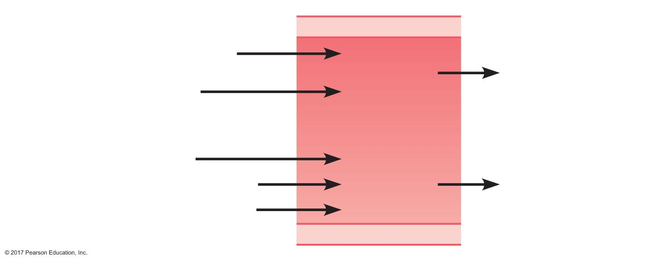
Figure 19.24 Inputs and outputs of acid to the blood.
Input
Output
Proteins
Diet
H⁺
Kidneys
Fats
Blood
[H⁺]
CO₂
Metabolism
Lactic acid
CO₂
Lungs
Keto acids

Slide 8

Sources of Acid-Base Disturbances
Respiratory disturbances
Carbon dioxide is a source of acid
CA
CO₂ + H₂O H₂CO₃ HCO₃– + H⁺
Normal P_{CO2} arterial blood = 40 mm Hg
Sources of CO₂: metabolism
Output of CO₂: through respiratory system
Increased plasma [CO₂] → respiratory acidosis
Decreased plasma [CO₂] → respiratory alkalosis

Slide 9
Respiratory acidosis can arise from a break in any one of these links:
For example, it can be caused from depression of the respiratory center through drugs or metabolic disease, or from limitations in chest wall expansion due to neuromuscular disorders or trauma.
It can also arise from pulmonary disease, cardiogenic pulmon aryedema, aspiration of a foreign body or vomitus, pneumothorax and pleural space disease, or through mechanical hypoventilation.

Slide 10
Respiratory alkalosis can be due to either direct or reflex hypoxemic stimulation of the respiratory center, to pulmonary disease, or to excessive mechanical ventilation.

Slide 11
Sources of Acid-Base Disturbances
Metabolic acidosis
Decreased pH through something other than CO₂
High-protein diet
High-fat diet
Heavy exercise
Severe diarrhea (loss of bicarbonate)
Renal dysfunction

Slide 12
Sources of Acid-Base Disturbances
Metabolic alkalosis
Increased pH through something other than CO₂
Excessive vomiting (loss of hydrogen ions)
Consumption of alkaline products (baking soda)
Renal dysfunction

Slide 13
Defense Mechanisms Against Acid-Base Disturbances
Three lines of defense
Buffering of hydrogen ions
Respiratory compensation
Renal compensation

Slide 14
Defense Mechanisms Against Acid-Base Disturbances
Buffering
Quickest defense against changes in pH
Most important ECF buffer = bicarbonate
HCO₃– + H⁺ H₂CO₃
ICF buffers
Proteins: Protein– + H₊ H•Protein
Phosphates: HPO₄^{2–} + H⁺ H²PO₄–

Slide 15
Defense Mechanisms Against Acid-Base Disturbances
Respiratory compensation
Second line of defense
Takes minutes to have an effect
Regulates pH by varying ventilation
Increased ventilation → decreased CO₂
Decreased ventilation → increased CO₂

Slide 16
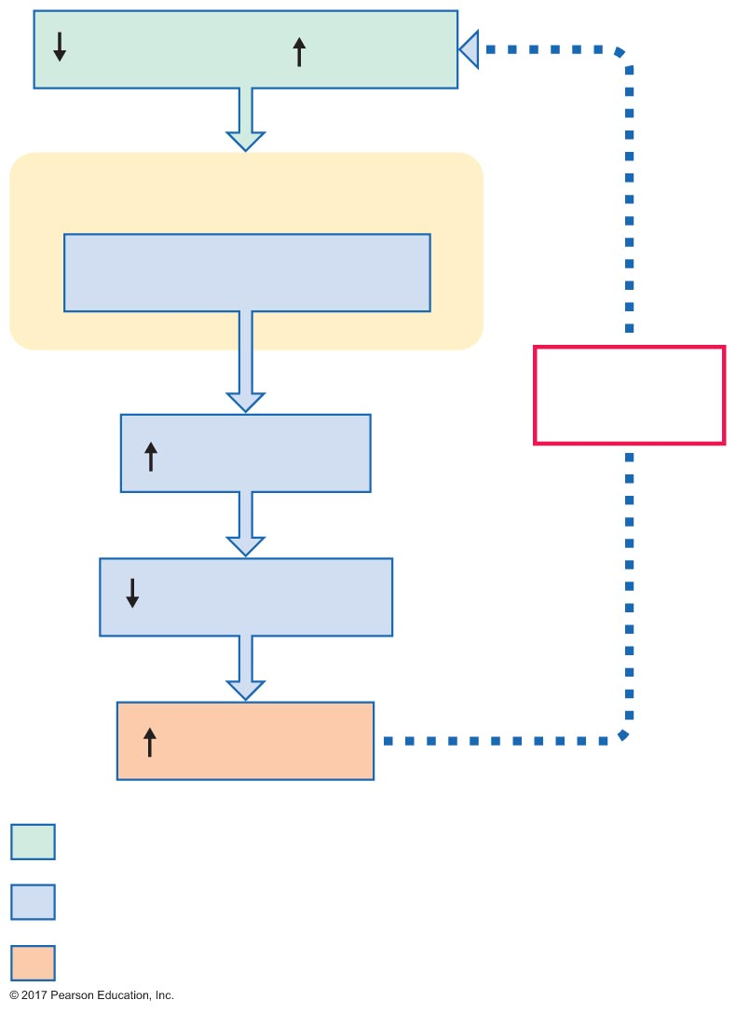
Figure 19.25 The mechanism by which decreases in plasma pH increase ventilation.
Plasma pH ( acidity)
Peripheral chemoreceptors
Detect and respond
Negative
feedback
Ventilation
Plasma P_{CO2}
Plasma pH
Initial stimulus
Physiological response
Result

Slide 17
Defense Mechanisms Against Acid-Base Disturbances
Renal compensation
Third line of defense
Takes hours to days
Regulates excretion of hydrogen ions and bicarbonate in urine
Regulates synthesis of new bicarbonate in renal tubules
Effects of increased acidity
Increased secretion of hydrogen ions
Increased reabsorption of bicarbonate
Increased synthesis of new bicarbonate

Slide 18
Defense Mechanisms Against Acid-Base Disturbances
Renal handling of hydrogen and bicarbonate ions
Proximal tubule
Bicarbonate reabsorption coupled to hydrogen ion secretion
Distal tubule and collecting duct
Secretion of hydrogen ions coupled to synthesis of new bicarbonate ions

Slide 19
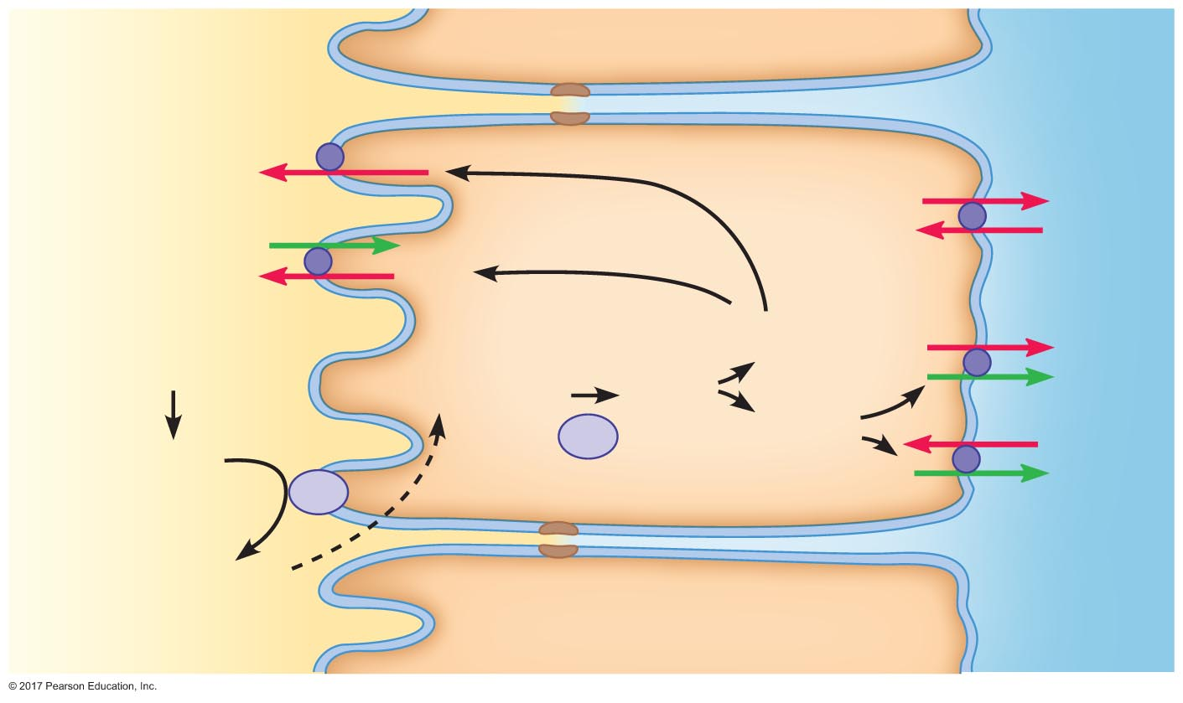
Figure 19.26 Bicarbonate reabsorption and hydrogen ion secretion in the proximal tubule.
Proximal tubule epithelial cell
H⁺
Na⁺
Na⁺
K⁺
H⁺
H⁺
(secreted)
HCO₃–
H⁺
+
Na⁺
(ﬁltered)
HCO₃–
CO₂ + H₂O
H₂CO₃
CA
HCO₃–
Cl–
H₂CO₃
HCO₃–
CA
H₂O + CO₂
Peritubular
ﬂuid
Tubular ﬂuid

Slide 20
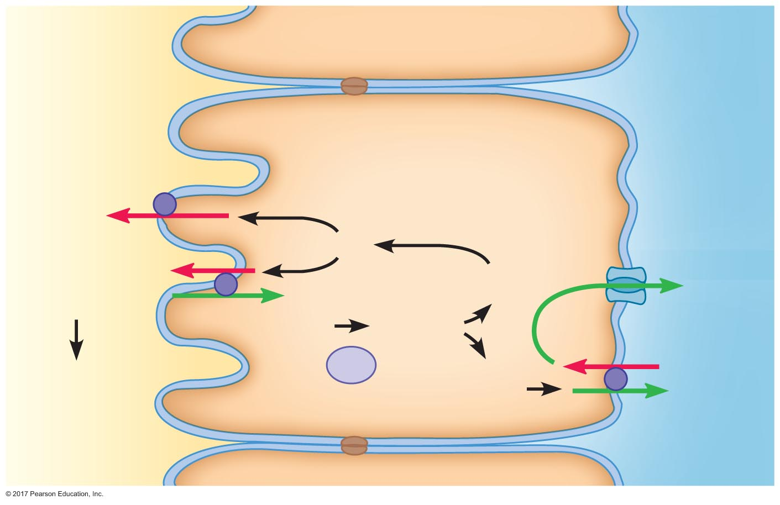
Figure 19.27 Bicarbonate synthesis and hydrogen ion secretion by intercalated cells of the distal tubule and collecting duct.
Tubular ﬂuid
Intercalated cell
Peritubular
ﬂuid
H⁺
H⁺
H⁺
H⁺
K⁺
Cl–
H⁺ + HPO₄^{2–}
CO₂ + H₂O
H₂CO₃
CA
Cl–
H₂PO₄–
HCO₃–
HCO₃–

Slide 21
Defense Mechanisms Against Acid-Base Disturbances
Glutamine in renal compensation
Regulation of hydrogen ion secretion, bicarbonate reabsorption, and bicarbonate synthesis by kidneys is usually sufficient
Severe acidosis
Glutamine metabolism produces new bicarbonate and secretes hydrogen in the form of ammonium

Slide 22
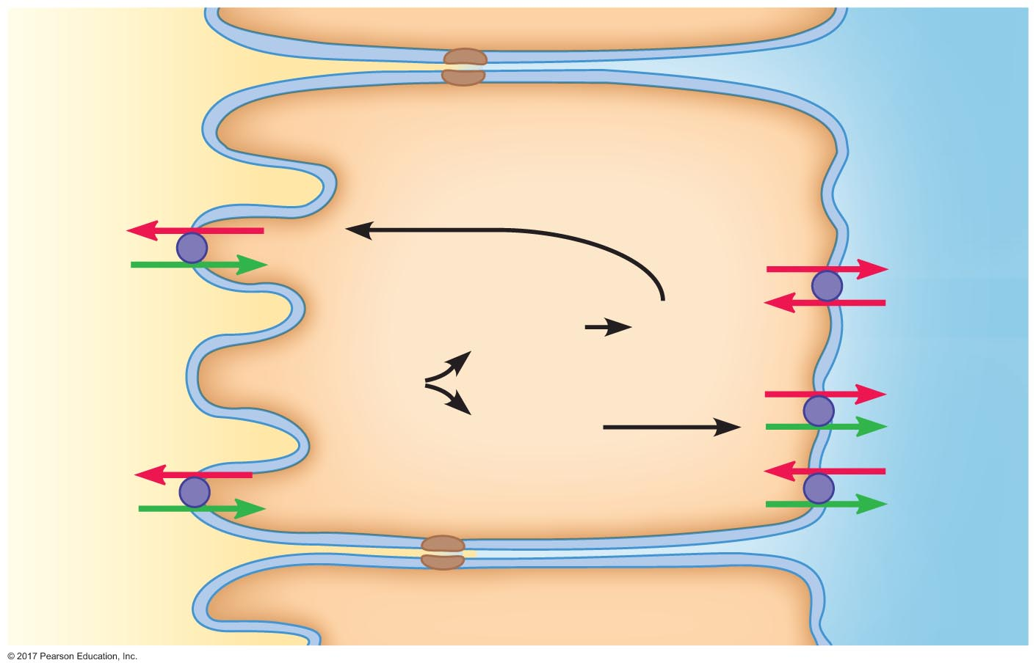
Figure 19.28 Bicarbonate production and hydrogen secretion by glutamine metabolism in the proximal tubule.
Peritubular
ﬂuid
Tubular
ﬂuid
NH₄⁺
Na⁺
Na⁺
K⁺
NH₃ + H⁺
NH₄⁺
Glutamine
Na⁺
HCO₃–
HCO₃–
H⁺
Cl–
Na⁺
HCO₃–

Slide 23
Compensation for Acid-Base Disturbances
Henderson-Hasselbalch equation
[HCO₃–]
pH = 6.1 + log
[CO₂]
For pH = 7.4, [HCO₃–]/[CO₂] = 20:1
Acidosis: [HCO₃–]/[CO₂] < 20:1
Alkalosis: [HCO₃–]/[CO₂] > 20:1
Kidneys regulate HCO₃–
Lungs regulate CO₂

Slide 24
Compensation for Acid-Base Disturbances
Respiratory acidosis
Cause: hypoventilation
Increased CO₂ → increased H⁺
Compensation: renal
Increased H⁺ secretion
Increased HCO₃– reabsorption

Slide 25
Compensation for Acid-Base Disturbances
Respiratory alkalosis
Cause: hyperventilation
Decreased CO₂ → decreased H⁺
Compensation: renal
Decreased H⁺ secretion
Decreased HCO₃– reabsorption

Slide 26
Compensation for Acid-Base Disturbances
Metabolic acidosis
Cause: increased H⁺ independent of CO₂
Compensation: respiratory and renal (unless renal problem)
Respiratory compensation
Increased ventilation → decreased CO₂
Renal compensation
Increased H⁺ secretion
Increased HCO₃– reabsorption
Increased synthesis of new bicarbonate

Slide 27
Compensation for Acid-Base Disturbances
Metabolic alkalosis
Cause: decreased H⁺ independent of CO₂
Compensation: respiratory and renal (unless renal problem)
Respiratory compensation
Decreased ventilation → increased CO₂
Renal compensation
Decreased H⁺ secretion
Decreased HCO₃– reabsorption
Decreased synthesis of new bicarbonate

Slide 28
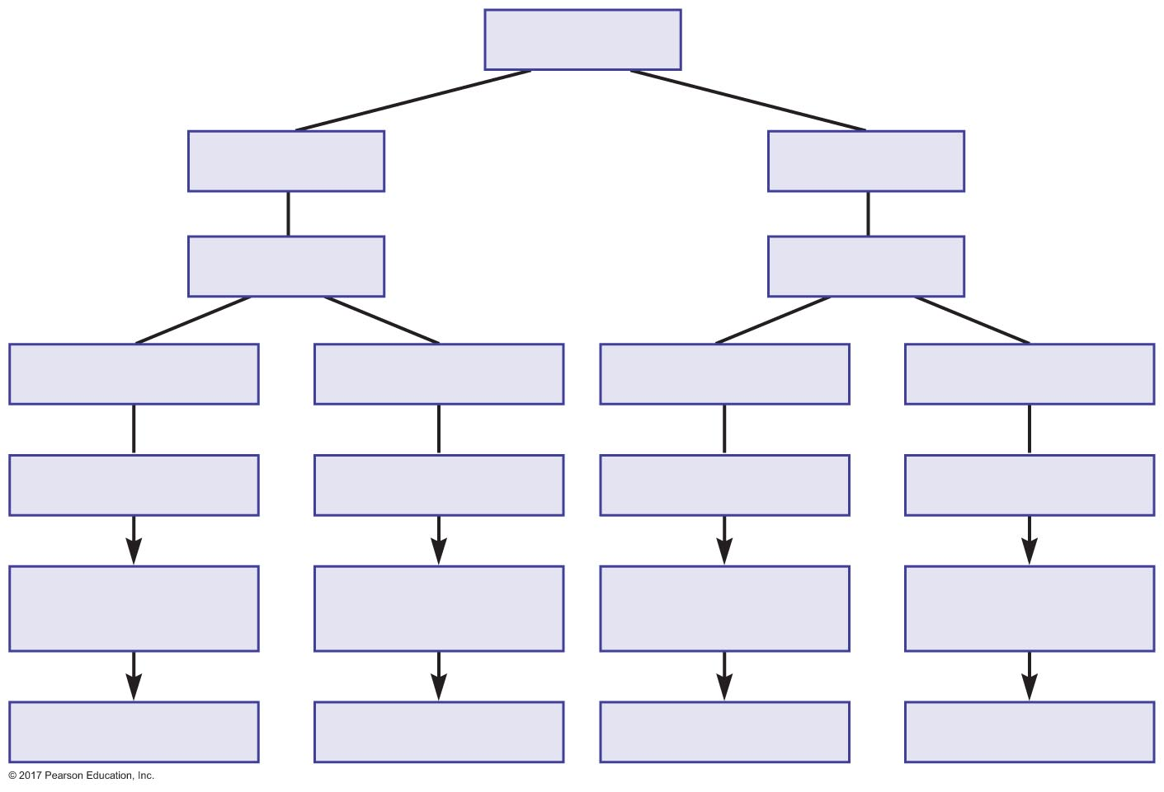
Figure 19.29 Summary of acid-base disturbances and compensation.
Slide 1
Arterial pH
pH < 7.35
OR
pH > 7.45
Acidosis
Alkalosis
[HCO₃–] < 24 mM
OR
P_{CO2} > 40 mm Hg
[HCO₃–] > 24 mM
OR
P_{CO2} < 40 mm Hg
Metabolic acidosis
Respiratory acidosis
Metabolic alkalosis
Respiratory alkalosis
Respiratory
compensation
Renal
compensation
Respiratory
compensation
Renal
compensation
P_{CO2} < 40 mm Hg
[HCO₃–] > 24 mM
P_{CO2} > 40 mm Hg
[HCO₃–] < 24 mM

Slide 29
The H-H equation defines the relationship between pH and the ratio of salt (bicarbonate) and weak acid (carbonic acid):
HCO3⁻(bicarbonate) + H⁺ ⇋ H₂ CO₃(carbonic acid) ⇋ CO₂ + H₂O

Slide 30
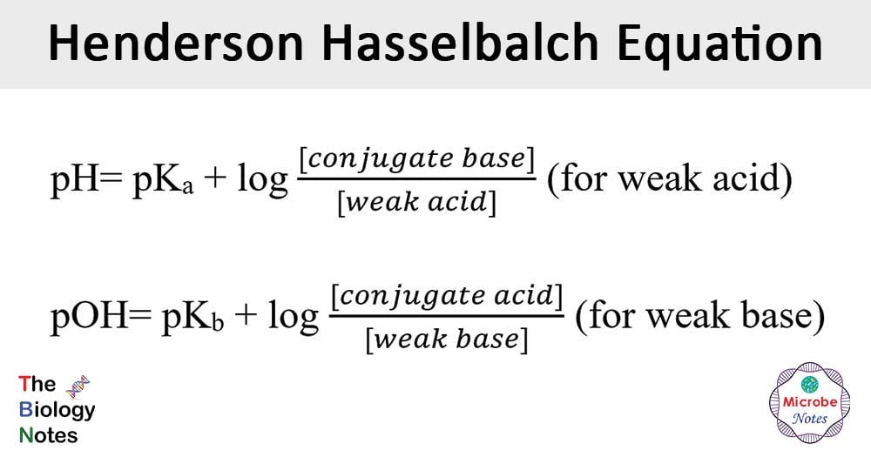

Slide 31
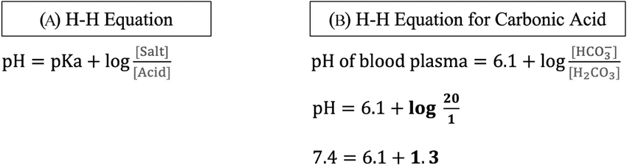

Slide 32
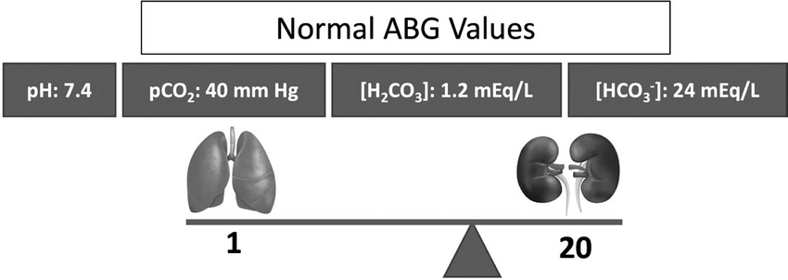
Carbonic acid-bicarbonate equilibrium illustrated as a level seesaw. The component on the lefthand side of the seesaw is [H 2 CO 3 ] obtained by converting from the ABG PCO 2 value. The component on the righthand side of the seesaw is [HCO 3 − ] and is obtained directly from the ABG results. Note how the fulcrum is off-center toward [HCO 3 − ] because the ratio of bicarbonate to carbonic acid is 20:1.

Slide 33
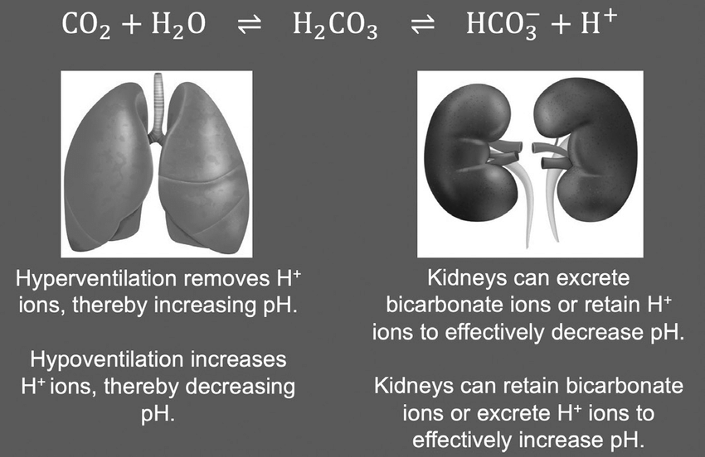

Slide 34
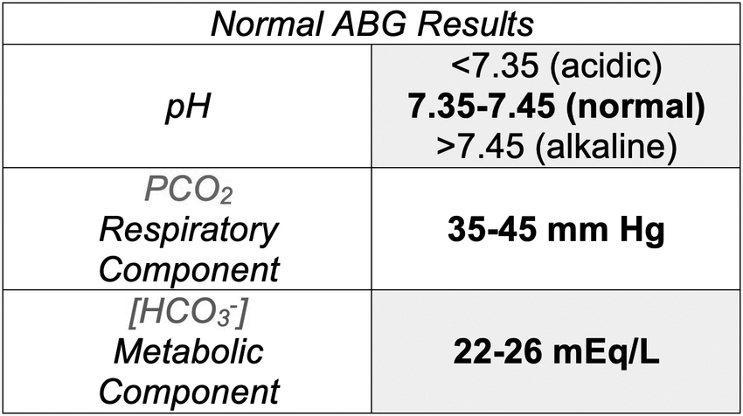

Slide 35
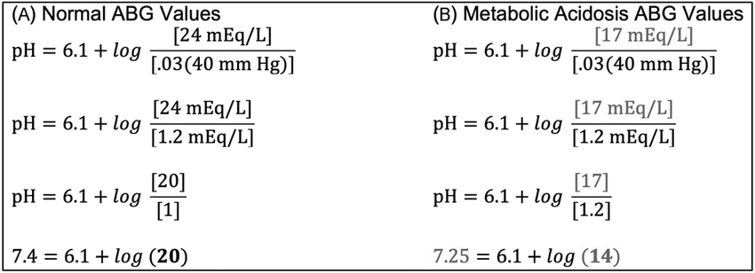
(A) Median normal values for [HCO₃⁻ ] and PCO₂ are used to demonstrate the calculation of pH using the Henderson-Hasselbalch equation. (B) Example of [HCO₃⁻ ] and PCO₂ values from a patient with an acid-base disorder. Since [HCO₃⁻ ] is <22, PCO₂ is normal, and pH is <7.35, this is a case of metabolic acidosis.

Slide 36
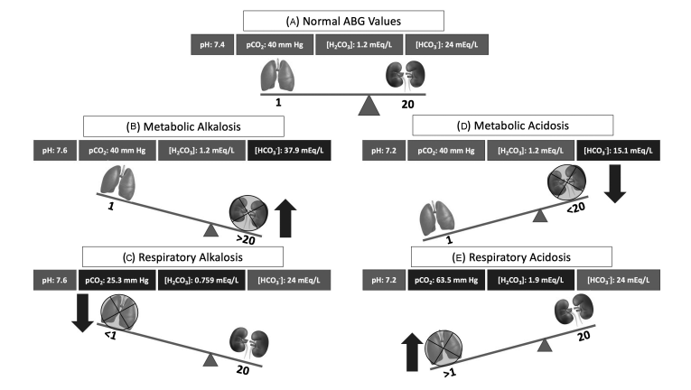

Slide 37
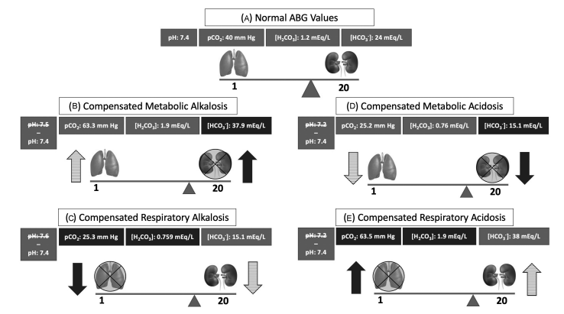

Slide 38
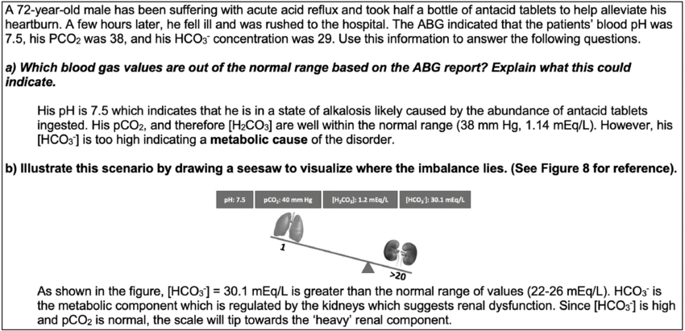

Slide 39
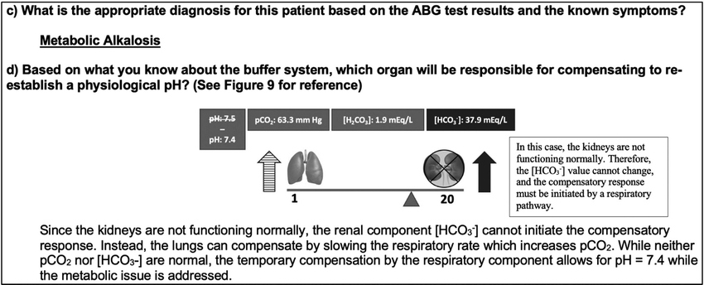

Slide 43
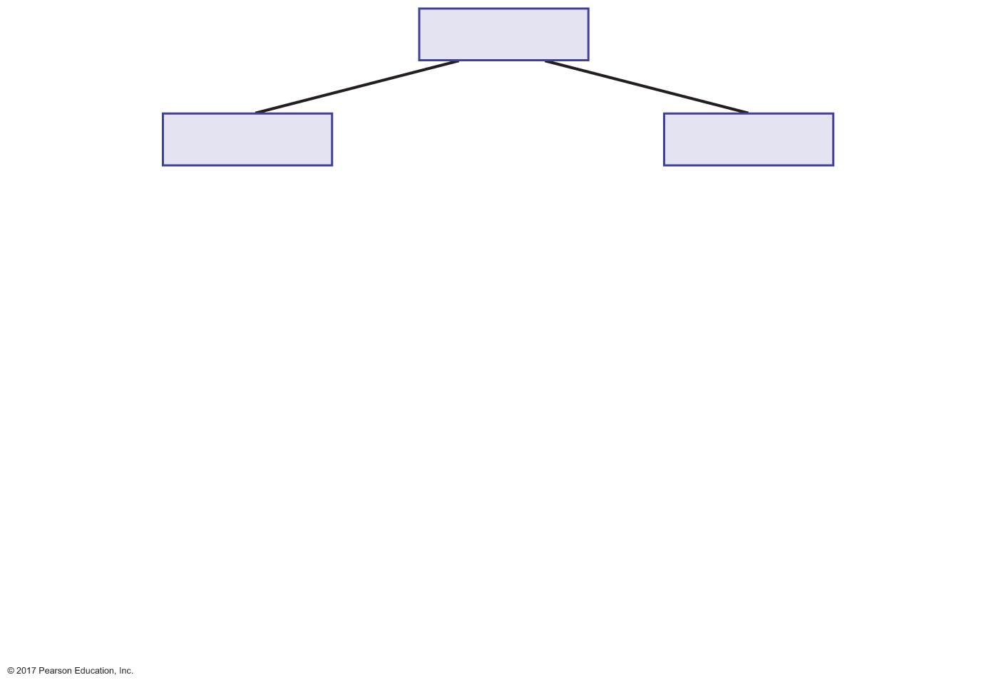
Figure 19.29 Summary of acid-base disturbances and compensation.
Slide 2
Arterial pH
pH < 7.35
OR
pH > 7.45

Slide 44
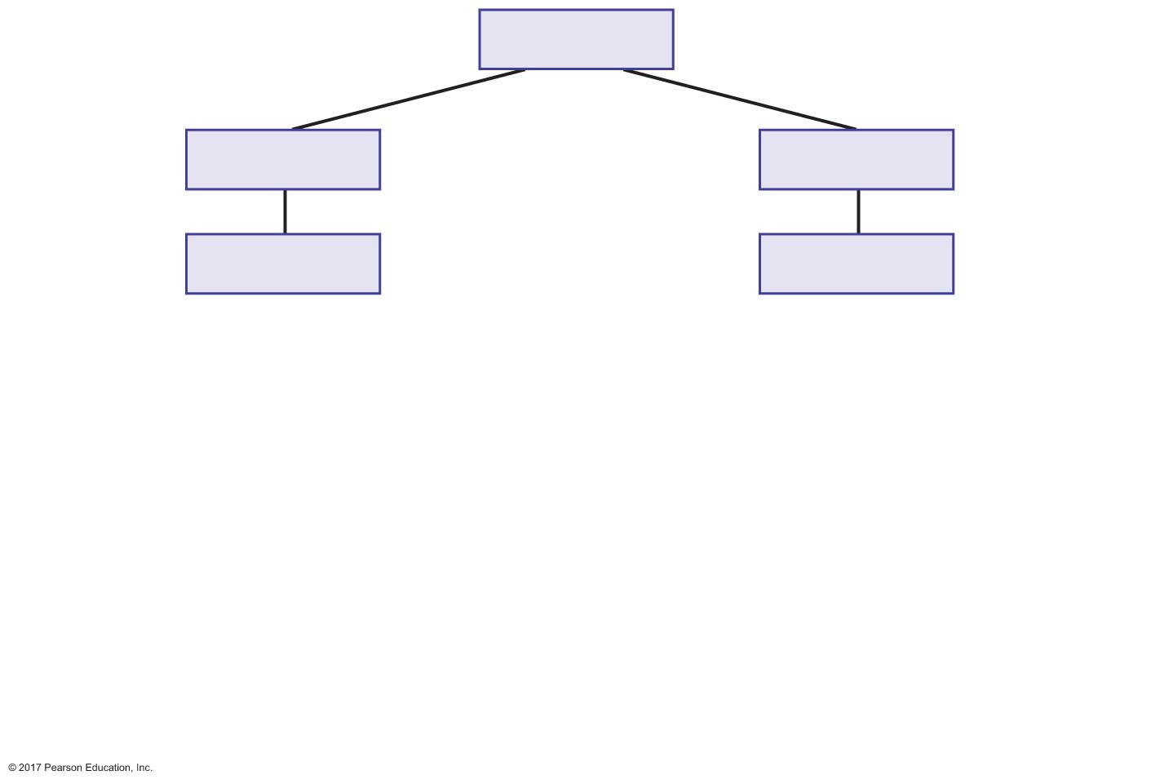
Figure 19.29 Summary of acid-base disturbances and compensation.
Slide 3
Arterial pH
pH < 7.35
OR
pH > 7.45
Acidosis
Alkalosis

Slide 45
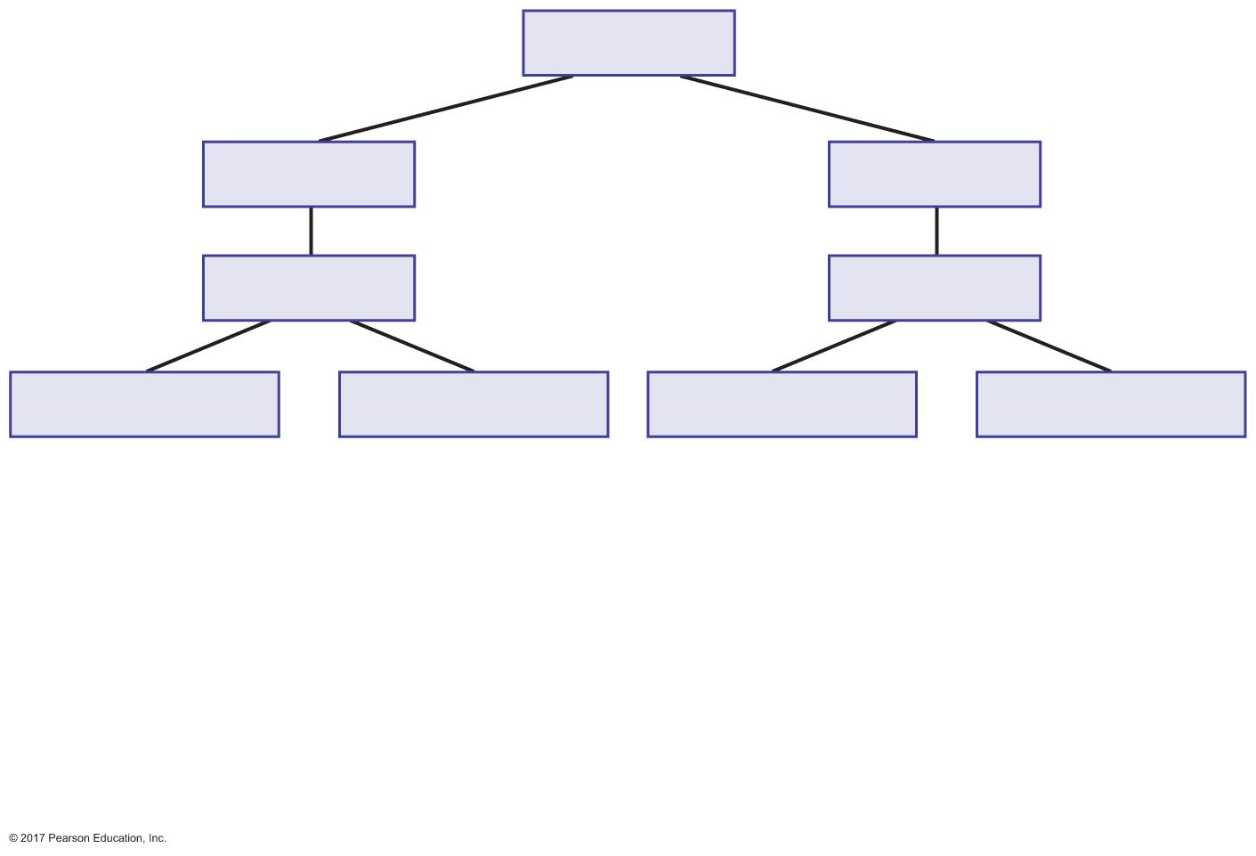
Figure 19.29 Summary of acid-base disturbances and compensation.
Slide 4
Arterial pH
pH < 7.35
OR
pH > 7.45
Acidosis
Alkalosis
[HCO₃–] < 24 mM
OR
P_{CO2} > 40 mm Hg
[HCO₃–] > 24 mM
OR
P_{CO2} < 40 mm Hg

Slide 46
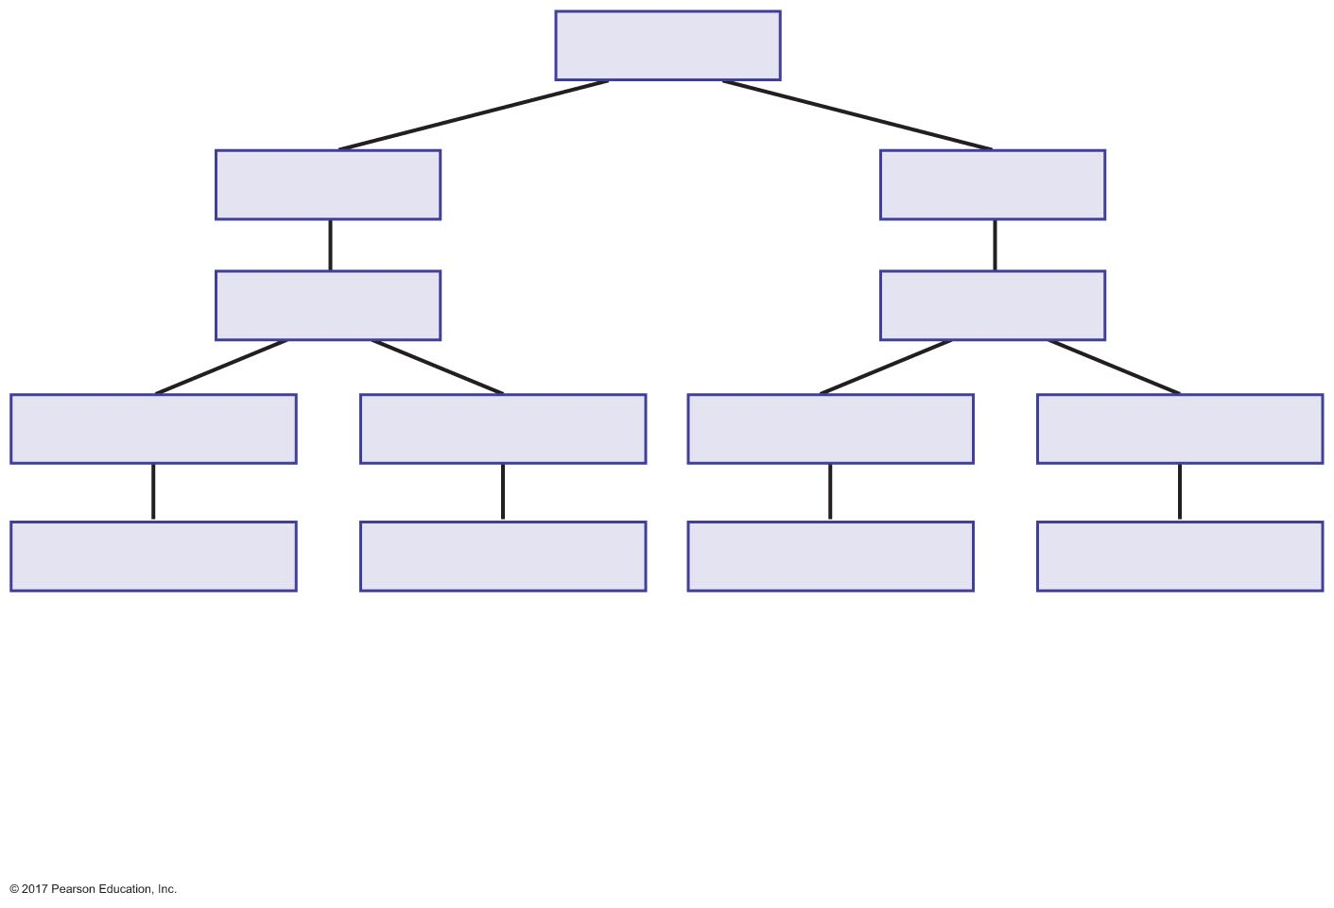
Figure 19.29 Summary of acid-base disturbances and compensation.
Slide 5
Arterial pH
pH < 7.35
OR
pH > 7.45
Acidosis
Alkalosis
[HCO₃–] < 24 mM
OR
P_{CO2} > 40 mm Hg
[HCO₃–] > 24 mM
OR
P_{CO2} < 40 mm Hg
Metabolic acidosis
Respiratory acidosis
Metabolic alkalosis
Respiratory alkalosis

Slide 47
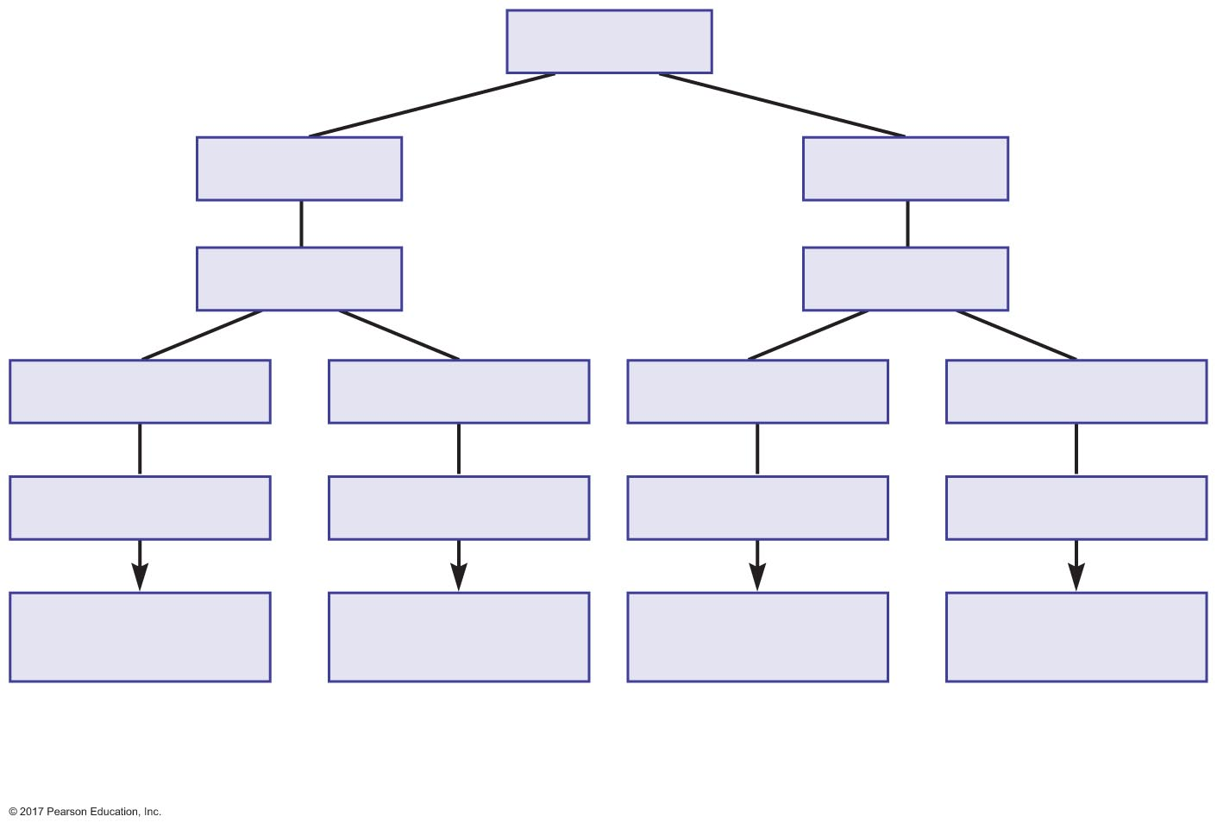
Figure 19.29 Summary of acid-base disturbances and compensation.
Slide 6
Arterial pH
pH < 7.35
OR
pH > 7.45
Acidosis
Alkalosis
[HCO₃–] < 24 mM
OR
P_{CO2} > 40 mm Hg
[HCO₃–] > 24 mM
OR
P_{CO2} < 40 mm Hg
Metabolic acidosis
Respiratory acidosis
Metabolic alkalosis
Respiratory alkalosis
Respiratory
compensation
Renal
compensation
Respiratory
compensation
Renal
compensation

Slide 48
Figure 19.29 Summary of acid-base disturbances and compensation.
Slide 7
Arterial pH
pH < 7.35
OR
pH > 7.45
Acidosis
Alkalosis
[HCO₃–] < 24 mM
OR
P_{CO2} > 40 mm Hg
[HCO₃–] > 24 mM
OR
P_{CO2} < 40 mm Hg
Metabolic acidosis
Respiratory acidosis
Metabolic alkalosis
Respiratory alkalosis
Respiratory
compensation
Renal
compensation
Respiratory
compensation
Renal
compensation
P_{CO2} < 40 mm Hg
[HCO₃–] > 24 mM
P_{CO2} > 40 mm Hg
[HCO₃–] < 24 mM

